Slide 1

TTHelper
Smart Timetable Management
DataQuest 2.0
67Mangomizer

Slide 2
MEET THE TEAM
Rohit A S Rohit Sinha Shyam K Krishnan
Nissim Arya Manas Chauhan
23BAI1416
22BCE5007
23BCE1632
24BEL1009
24BRS1012

Slide 3
Overview
01
02
03
Problem Statement
UI/UX design
Collect Data
04
05
06
Define Rules
Run the AI
Test and Refine

Slide 4
Problem Statement:
Creating timetables for colleges and universities is a very complex and
time-consuming process. It's done mostly by hand, which often leads to mistakes like scheduling conflicts between classes, professors, and
classrooms. This inefficiency causes frustration for students and faculty and can waste valuable resources.

Slide 5
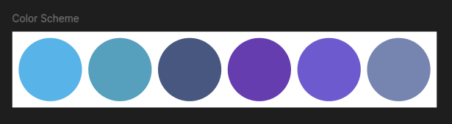
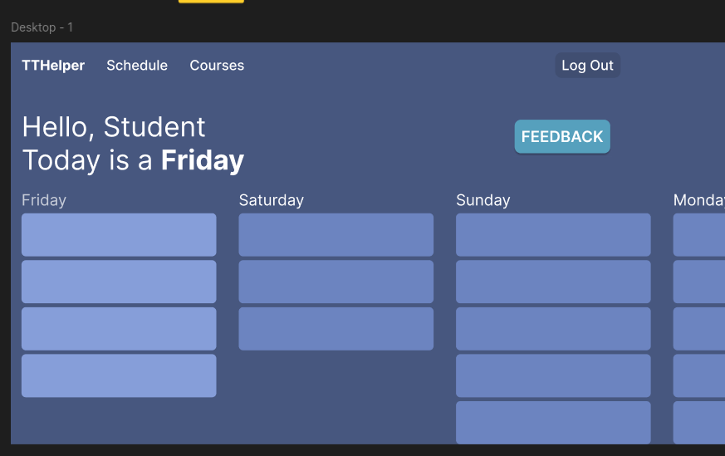
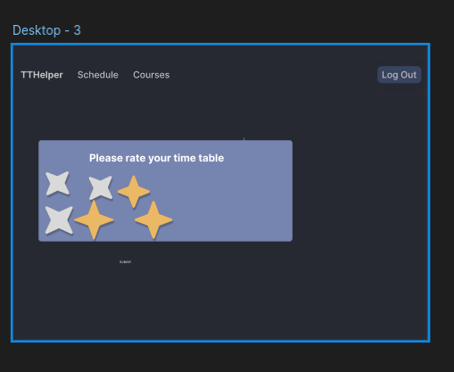
The UI/UX design Design
Designed in figma

Slide 6
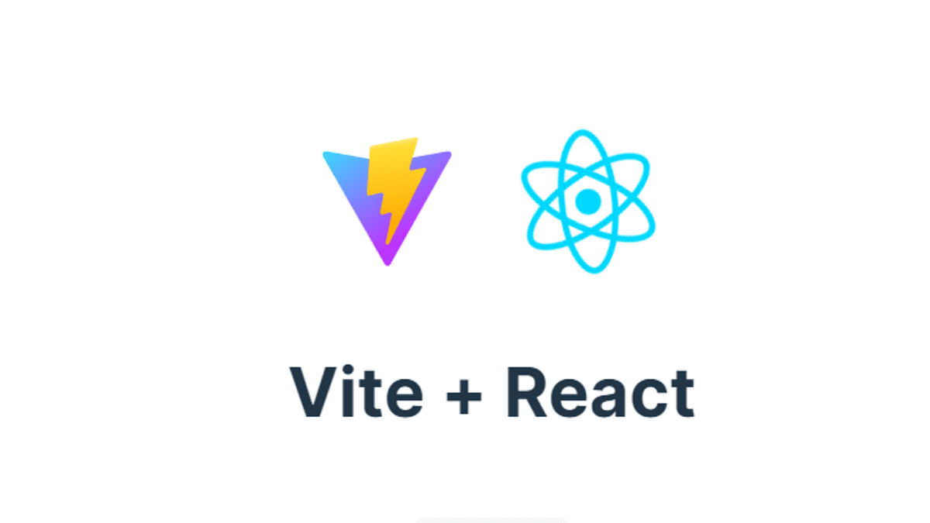


Tech Stack
Frontend
React
React Router DOM
Tailwind CSS
React Icons
Vite 7.1.2
Backend
Flask
Flask-JWT-Extended
Flask-CORS
PyMongo
Python-Constraint
Database
MongoDB Atlas

Slide 7
Algorithm Approach
Constraint Satisfaction Problem (CSP)
The timetable generation uses a sophisticated CSP approach:
Variables: Each course that needs to be scheduled
Domain: Time slots across 7 days × 12 hours (84 total slots)
Constraints:
No two courses can occupy the same time slot
All courses must be assigned a unique time slot
Faculty availability constraints

Slide 8
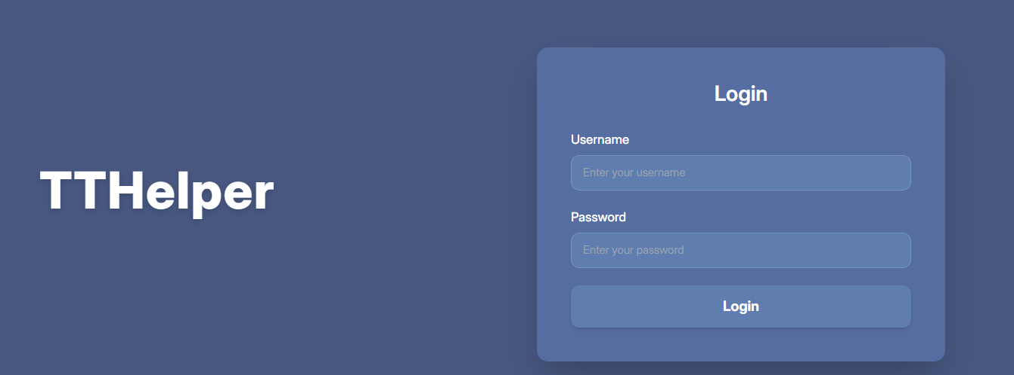
Login page with different roles for student, faculty, and admin

Slide 9
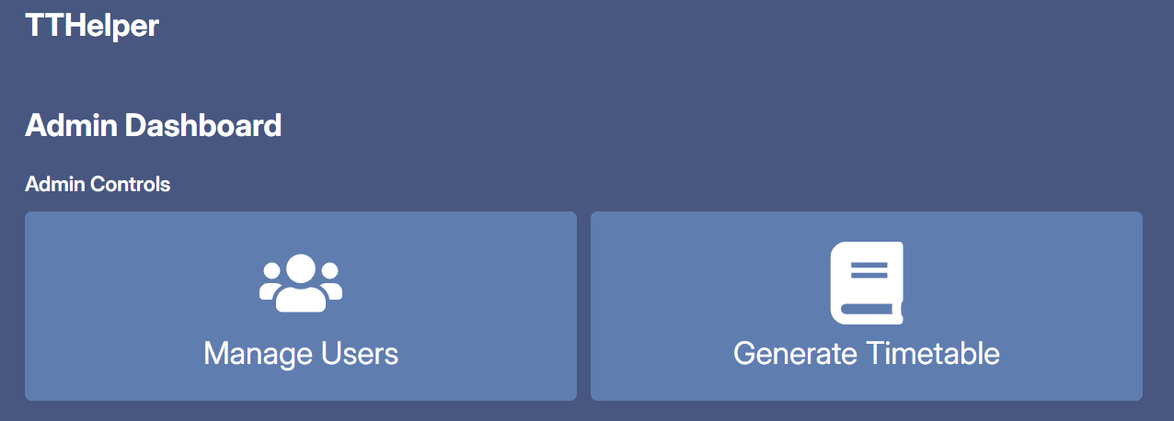
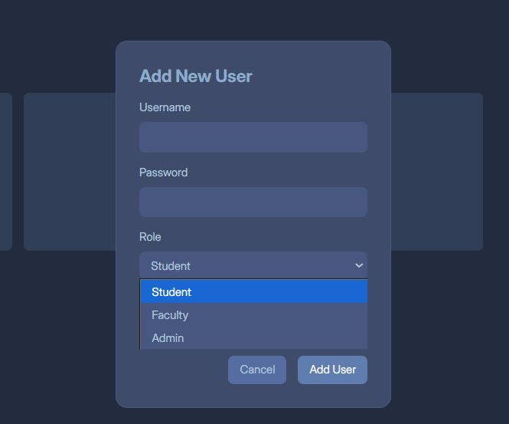
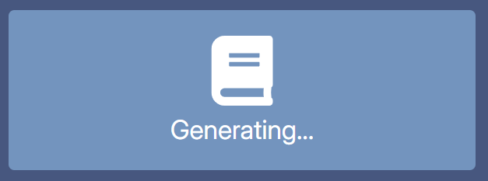
Admin can create accounts for different roles and generate new timetables

Slide 10
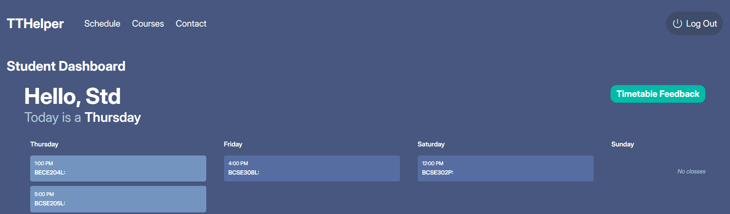
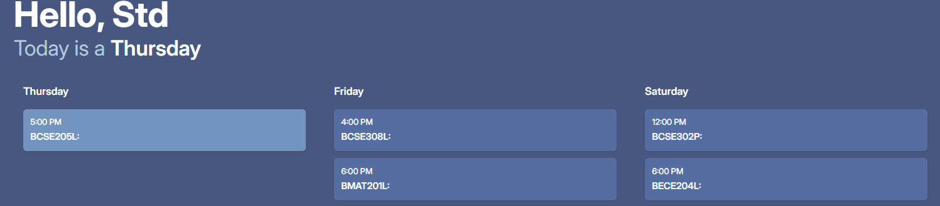
Student dashboard showing their schedule
They can give feedback on the timetable for improving it in the next iteration

Slide 11
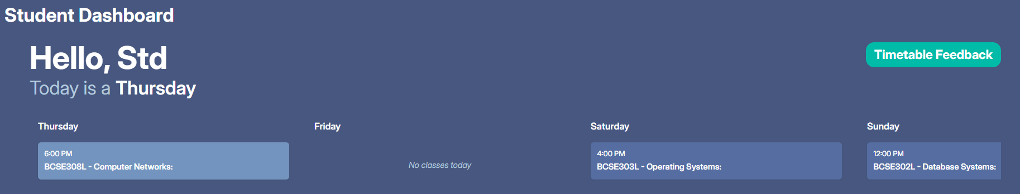
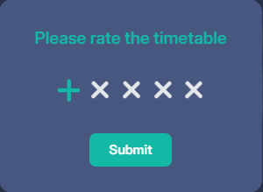
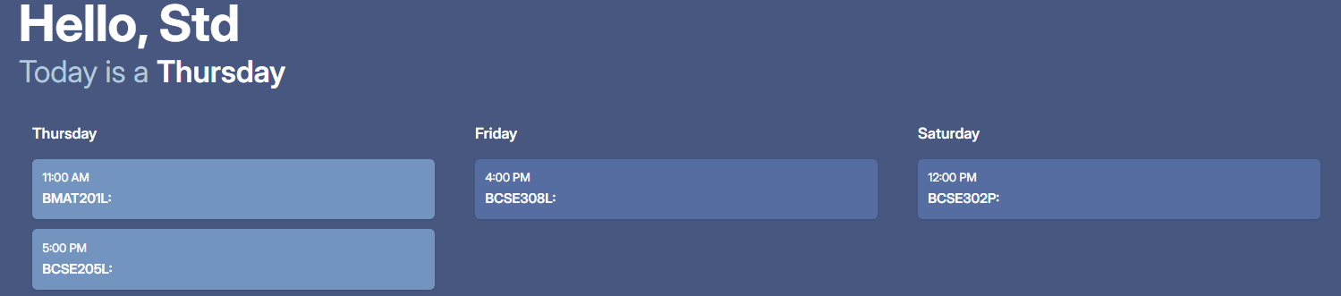
Student dashboard showing their schedule
They can give feedback on the timetable for improving it in the next iteration

Slide 12
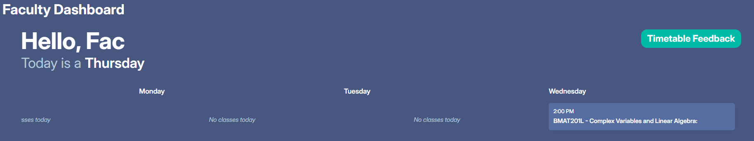
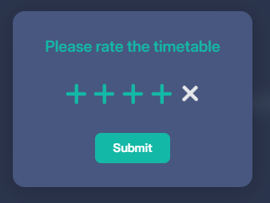

Faculty dashboard showing their schedule
They give feedback carrying more weightage than students on the timetable for improving it in the next iteration

Slide 13
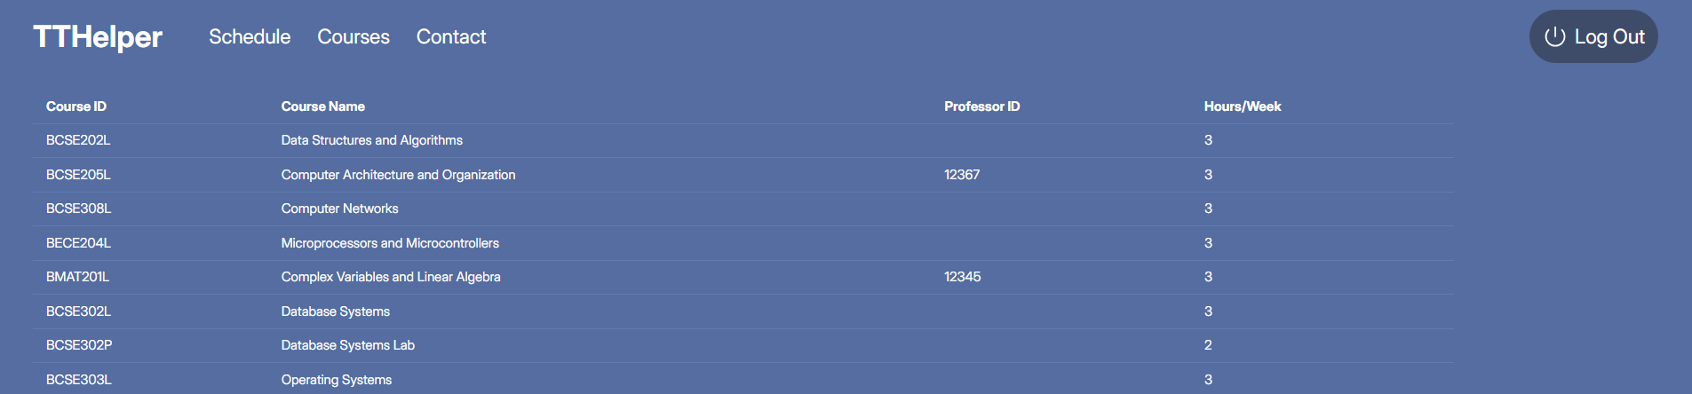
Courses page with the courses available and faculties taking them

Slide 14
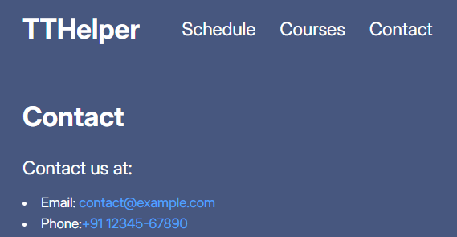
Contact page for troubleshooting and bugs

Slide 15
Thank You

